Slide 1

JS API based customizations for improving your Alfresco experience
César Capillas <cesar at zylk.net>

Slide 2



About me
I’m an IT/Solution Architect at zylk.net, an OOTB member working with Alfresco-based solutions during the last 8 years in large organisations. I am one of the authors of a corporate Alfresco Blog, addons developer and a very active user in Alfresco Community.
https://www.linkedin.com/in/cesarcapillas
http://www.zylk.net/alfresco-blog

Slide 3

Intro and motivations
Javascript API based customizations to improve your Alfresco experience
https://github.com/zylklab/

Slide 4
Introduction and motivations (I)
Alfresco ecosystem has lots of very useful third party addons (Javascript Console, Support Tools, Site Creators, Uploader Plus).
These extensions fill the gap of Alfresco by default, customizing some default behaviour (i.e. Site Creators addon).
Other extensions are also typical (e.g.: to hide external users invite form, custom themes, maximum number of versions or quota policies)
Then, customers want to customize a little bit more.

Slide 5
Introduction and motivations (II)
We show a set of Alfresco customizations as examples of:
Simple extensions for improving Alfresco default functionality, resulting from conversations with customers.
Also presented as examples of Alfresco content models, forms extensions, JS actions, JS-based behaviours, quartz jobs examples, custom indicators, metadata templates or smart templates.

Slide 6
Alternative to AOS
Edit online with Libreoffice
https://github.com/zylklab/alfresco-share-online-edition-addon

Slide 7
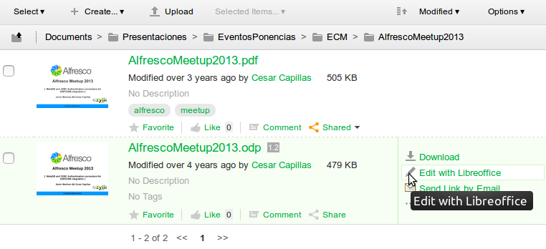
Edit online with Libreoffice action
Protocol-based webdav online edition with Libreoffice 5
It uses dav:// protocol URL-schemes (for Windows and Linux)
Libreoffice mimetypes
Non-SSL installations

Slide 8
Edit online with Libreoffice action
Protocol-based webdav online edition with Libreoffice 5
It uses dav:// protocol URL-schemes (for Windows and Linux)
Libreoffice mimetypes
Non-SSL installations

Slide 9
Set status to documents
How can I manage document edition lifecycle in a simple way ?
https://github.com/zylklab/zk-zpm-statusable

Slide 10
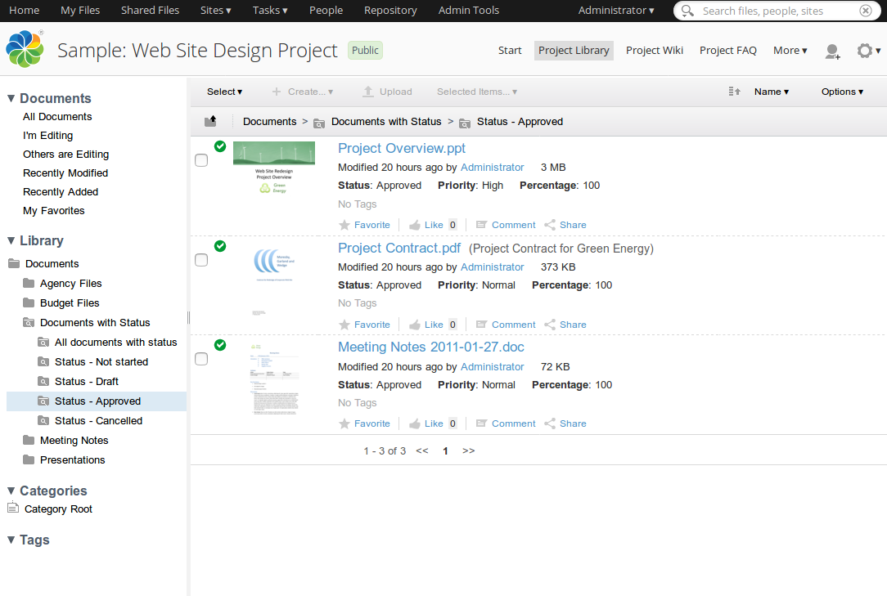
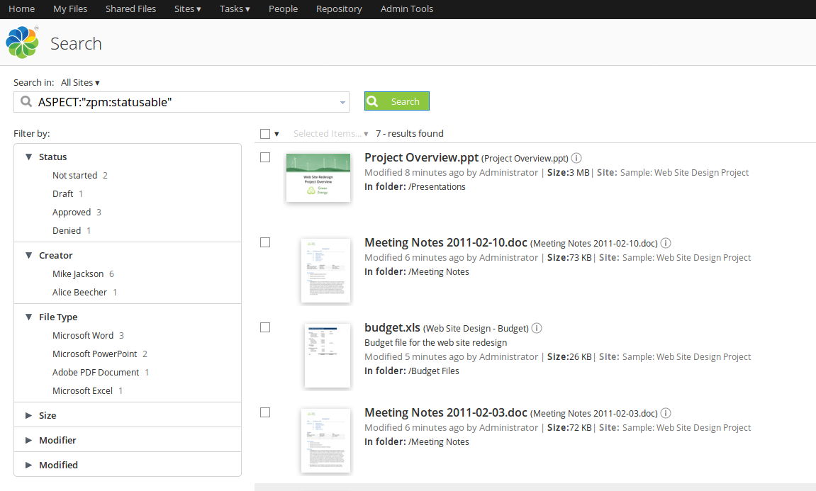
Status-able indicators
Aspect for document status
Custom indicators and metadata template for the statusable aspect
Document searches with facets
Document views with smart folders

Slide 11
Status-able indicators
Aspect for document status
Custom indicators and metadata template for the statusable aspect
Document searches with facets
Document views with smart folders

Slide 12
Public URLs w/ expiration
How can I manage and control the public shared documents ?
https://github.com/zylklab/zk-qshared-effectivity

Slide 13
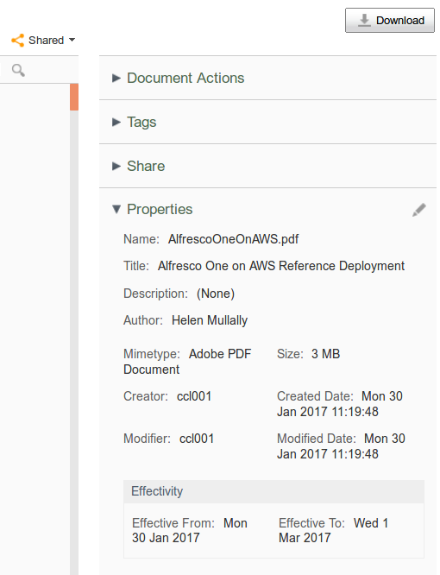
Public URLs with expiration
Using cm:effectivity aspect for defining a date expiration for this content
A content behaviour for setting automatically a month
A daily quartz job for removing qshare:qshared aspect
Custom indicators and metadata templates
Smart template

Slide 14
Public URLs with expiration
Using cm:effectivity aspect for defining a date expiration for this content
A content behaviour for setting automatically a month
A daily quartz job for removing qshare:qshared aspect
Custom indicators and metadata templates
Smart template

Slide 15
Custom Search Dashlet
How can I add business views in user and site panels ?
https://github.com/zylklab/zk-dynamic-searches-dashlet

Slide 16
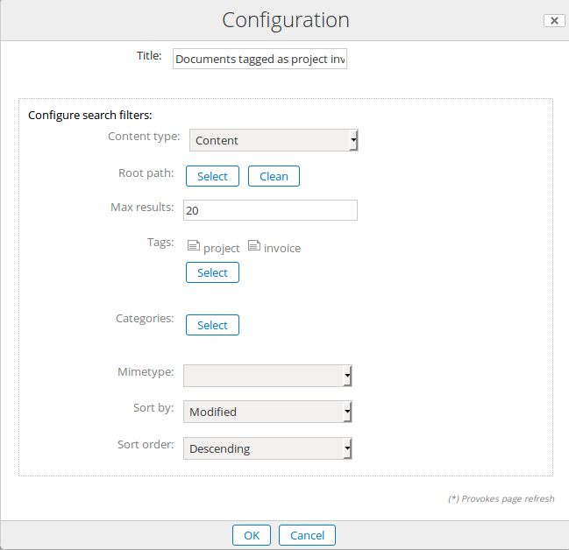
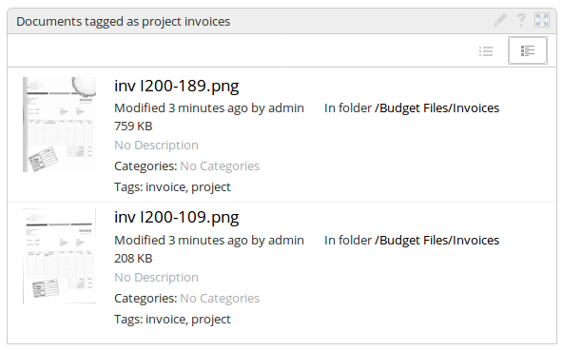
Custom Search Dashlet
Search dashlet with many filters
Custom Types, multiple tags and categories…
Use PATH queries in combination with smart folder templates for complex queries

Slide 17
Custom Search Dashlet
Search dashlet with many filters
Custom Types, multiple tags and categories…
Use PATH queries in combination with smart folder templates for complex queries

Slide 18
Alfresco URL Shortener
How to use short URLs in Alfresco Share ?
https://github.com/zylklab/zk-url-shortener

Slide 19
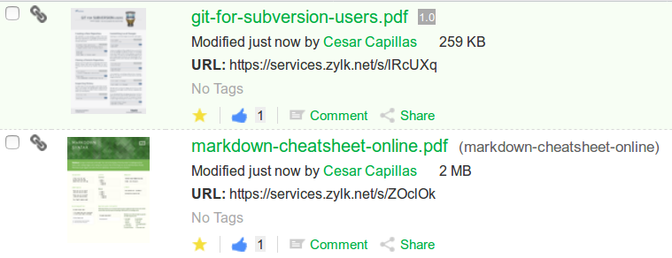
Alfresco URL Shortener
Simple to use and share, such as bit.ly...
Not dependant on the uuid
It needs a frontend (i.e. Apache) for rewriting URLs

Slide 20
Alfresco URL Shortener
Simple to use and share, such as bit.ly...
Not dependant on the uuid
It needs a frontend (i.e. Apache) for rewriting URLs

Slide 21
Conclusion
Alfresco customizations are fun, even more fun if open-source
You can improve and extend Alfresco capabilities with simple extensions
You can use them as Javascript API training pills
Please fork, share and use them in your Alfresco installations
https://github.com/zylklab/beecon2017

Slide 22
Thank you for your attention!
César Capillas <cesar at zylk.net>
@zylknet
http://www.github.com/zylklab

